Slide 1

Analysis of Neural Models for Sandhi Splitting in Ayurvedic Sanskrit Texts
Guided by,
Bri Jayasree Nair
Abhiram A S AM.EN.U4AIE22002
Karthik Narayan C AM.EN.U4AIE22028
Harigovind C B AM.EN.U4AIE22119

Slide 2
Outline
Introduction
Problem Definition
Objectives
Literature Review Summary
Research Gap
Dataset Description
Methodology / Proposed Method
Design / Architecture
Evaluation Metrics
Result Analysis
Limitations
Phase II plan
Reference

Slide 3
Introduction
Ayurvedic Sanskrit texts such as the Charaka Saṃhitā and Suśruta Saṃhitā contain extensive medical knowledge accumulated over centuries.
However, their computational processing is challenging due to linguistic complexities like sandhi, samāsa, rich morphology, and free word order. Recent advances in AI and NLP provide promising techniques for processing such classical texts.
This project focuses on evaluating existing models applied to Ayurvedic Sanskrit for sandhi splitting.

Slide 4
Problem Definition
Ayurvedic Sanskrit texts are difficult to process computationally because of complex linguistic phenomena such as sandhi formation, compound words, and inflectional richness.
Existing NLP models show varying performance. There is a need for a systematic approach for sandhi splitting involving Ayurvedic texts.
There is a lack of comprehensive and dedicated models for Sandhi splitting Ayurvedic Sanskrit texts. The absence of such models leads to inconsistent and unreliable Sandhi splitting, particularly in complex compound formations and verse-level text.

Slide 5
Objectives
To compare AI and NLP models for processing Ayurvedic Sanskrit texts
To evaluate models on sandhi-splitting, morphological analysis, and NER
To analyse strengths and limitations of rule-based, statistical, and transformer-based models
To assess model performance using standard evaluation metrics
To identify challenges specific to Sanskrit NLP
To recommend suitable models for future Ayurvedic knowledge extraction systems

Slide 6
Literature Review Summary
Paper Title | Methodology | Dataset | Limitations
A Benchmark and Dataset for Post-OCR text correction in Sanskrit | Seq2seq correction baselines for Sanskrit OCR | 218k Sanskrit OCR corrected sentences. | Needs Ayurveda specific adaptation. not domain focused
NLP-Based Knowledge Extraction from Charak Samhita for Navigating Ancient Wisdom | Django system: OCR + NER + query interface | OCR’d Charaka Saṃhitā | Used translations, Sanskrit-native pipeline needed
Digital Corpus of Sanskrit: Towards Improved Segmentation and Normalization | Normalization & segmentation improvements for Sanskrit | Digital Corpus of Sanskrit (DCS) | Lacks Ayurvedic corpora; calls for domain specific expansion
Building Named Entity Resources for Sanskrit Texts | Pre annotation + bilingual alignment + gazetteers | Śrīmad-Bhāgavatam subset (NER corpus) | Entities limited to persons/places. Ayurveda entities missing
Mapping Research Trends in Ayurveda: A Bibliometric Study (1993 2022) | Bibliometric mapping of Ayurveda research | 11,773 Ayurveda publications | Not technical NLP; shows domain significance
Advances in Morphological Segmentation and Compound Analysis in Sanskrit | Morpho syntactic parsing for Sanskrit | Sanskrit Digital Corpus | No Ayurvedic integration; useful for preprocessing
Sanskrit Semantic Parsing for Knowledge Extraction | Semantic parsing for extracting relations | Sanskrit annotated datasets | Not domain specific; Ayurveda corpus missing

Slide 7
Research Gap
Lack of integration of contemporary Pre-trained Language Models with Ayurveda
Lack of domain-specific annotated corpora
Inadequate handling of complex Sanskrit linguistic phenomena in domain context

Slide 8
Dataset Description
Source texts: Charaka Saṃhitā
Source: University of Hyderabad
Data type: Sanskrit verses with chapter markers
Dataset size: Small, manually annotated

Slide 9
Methodology / Proposed Method
Dataset Preparation – Selection and automated annotation of verses
Preprocessing – Normalization, tokenization, cleaning
Task Evaluation – Sandhi-splitting
Evaluation of different models for Sandhi Splitting

Slide 10
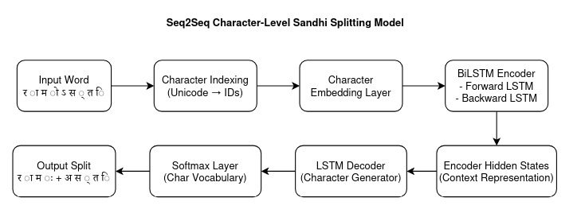
Architecture - Seq2Seq

Slide 11
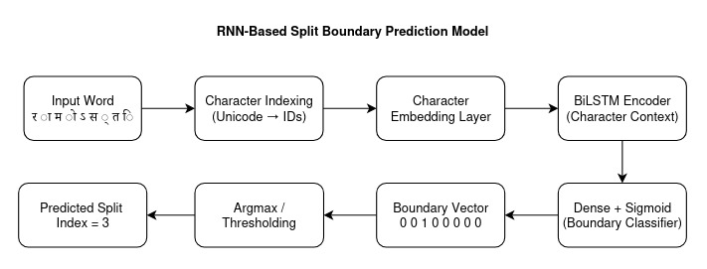
Architecture - RNN

Slide 12
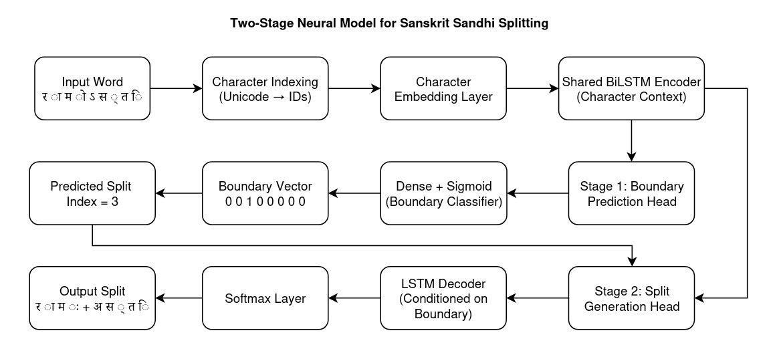
Architecture - SandhiWindow

Slide 13
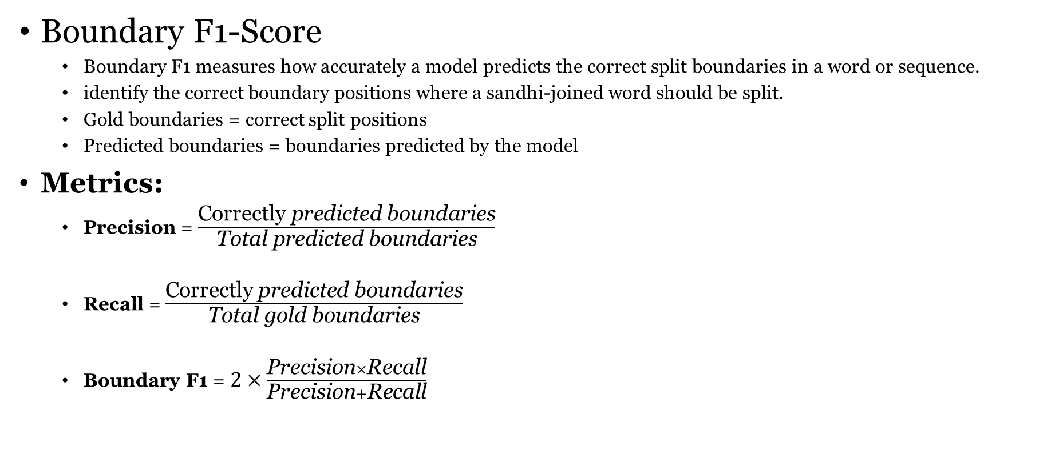
Evaluation Metrics
Boundary F1-Score
Boundary F1 measures how accurately a model predicts the correct split boundaries in a word or sequence.
identify the correct boundary positions where a sandhi-joined word should be split.
Gold boundaries = correct split positions
Predicted boundaries = boundaries predicted by the model
Metrics:
Precision = $\frac{\text{Correctly} \text{predicted} \text{boundaries}}{\text{Total} \text{predicted} \text{boundaries}}$
Recall = $\frac{\text{Correctly} \text{predicted} \text{boundaries}}{\text{Total} \text{gold} \text{boundaries}}$
Boundary F1 =$2×\frac{\text{Precision}×\text{Recall}}{\text{Precision}+\text{Recall}}$

Slide 14
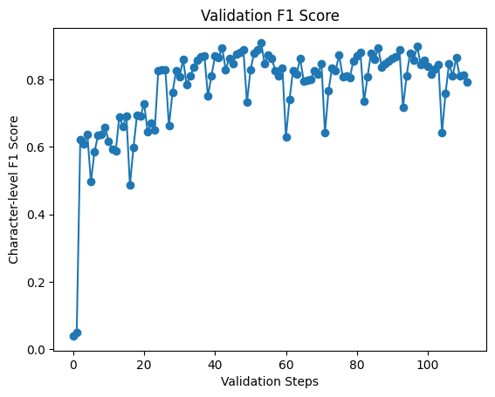
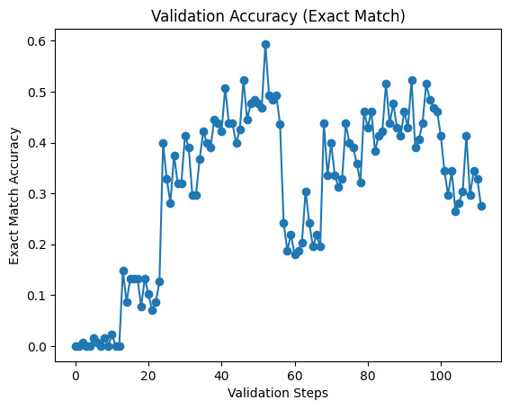
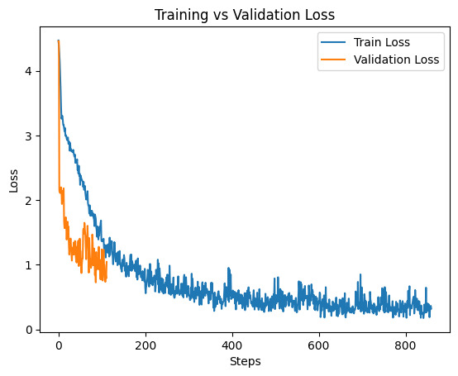
Result Analysis - Seq2Seq

Slide 15
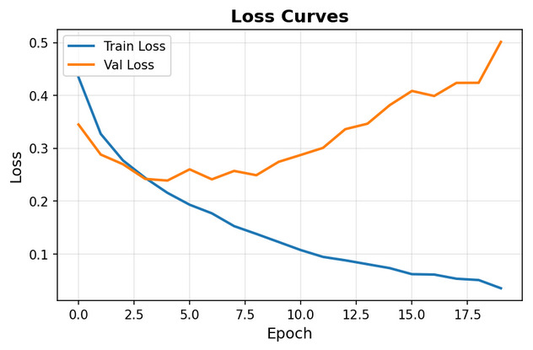
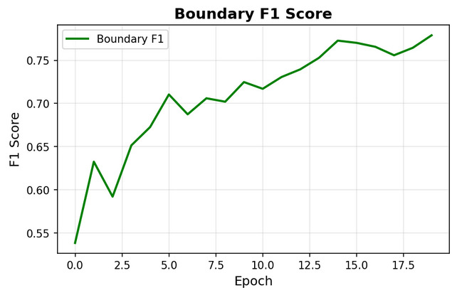
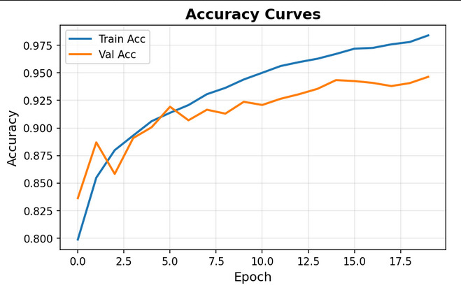
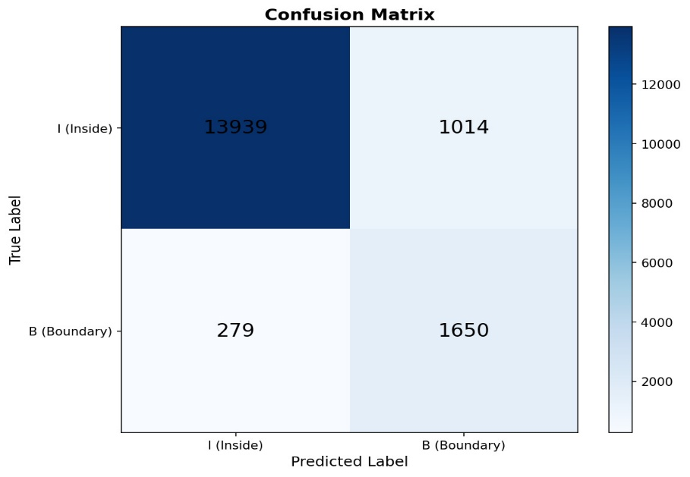
Result Analysis - RNN

Slide 16
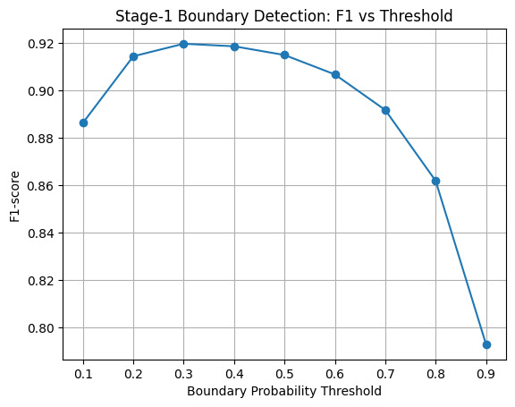
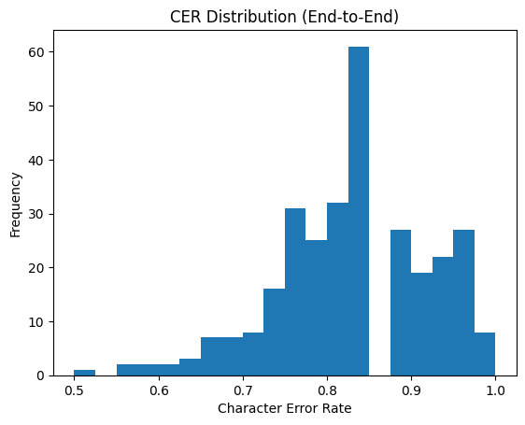
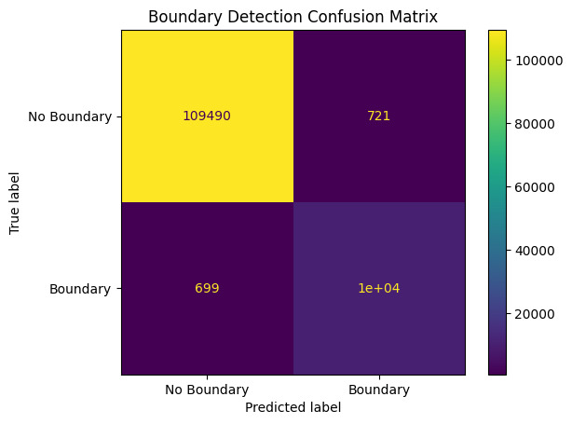
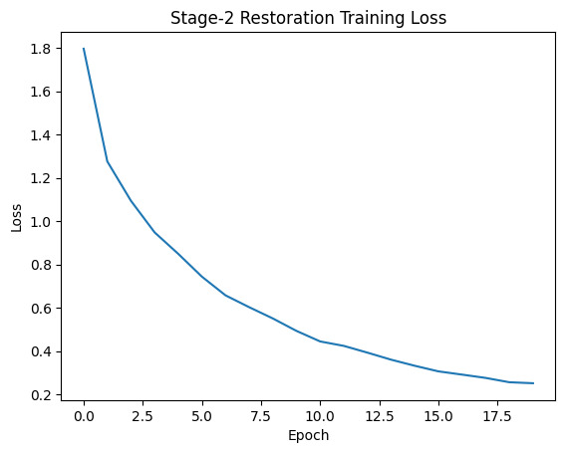
Result Analysis - SandhiWindow

Slide 17
Limitations
Handling of Complex Sandhi and Compounds Long compound words (samāsa) and complex sandhi formations remain challenging, leading to segmentation and interpretation errors.
Lack of Relation Extraction The current work focuses primarily on segmentation, morphology, and entity recognition, without extracting semantic relations between entities.
Limited Annotated Dataset The models were trained on a relatively small, manually annotated dataset, which restricts generalization to larger and more diverse Ayurvedic texts.

Slide 18
Phase II Plan (Proposed)
Fine-Tuning Domain-Specific Language Models Further fine-tune advanced Sanskrit pre-trained language models specifically on Ayurvedic corpora to improve performance on medical entities and relations.
Hybrid NLP Approaches Explore hybrid models that combine rule-based linguistic knowledge with transformer-based deep learning to better handle sandhi, long compounds, and free word order.
Clinical and Educational Applications Apply the extracted structured knowledge to clinical decision support systems, digital textbooks, and intelligent Ayurvedic search engines.

Slide 19
Reference
Aralikatte, R., Gantayat, N., Panwar, N., Sankaran, A., & Mani, S. (2019). Sanskrit sandhi splitting using seq2(seq)².
Hellwig, O. (2015). Using recurrent neural networks for joint compound splitting and Sandhi resolution in Sanskrit.
Dave, S., Singh, A. K., P., P. A., & Lall, B. (2020). Neural compound-word (Sandhi) generation and splitting in Sanskrit language

